Slide 1
HR ANALYSIS
Employee Satisfaction & Retention rate

Slide 2
ABOUT
HR Analysis is a powerful tool used by organizations to gain insights into employee performance, satisfaction, and overall workforce management. It involves analyzing various factors that influence employee behavior, productivity, and retention.
The analysis typically includes data from multiple dimensions such as department, employee satisfaction, work accidents, number of projects, last evaluation scores, promotion rates, and monthly working hours.
This data is crucial for HR departments to make informed decisions that enhance employee engagement, reduce turnover, and improve overall organizational effectiveness
By analyzing these metrics, HR teams can identify trends, uncover potential issues, and implement strategies to improve employee satisfaction, productivity, and safety, ultimately contributing to the organization's success.

Slide 3
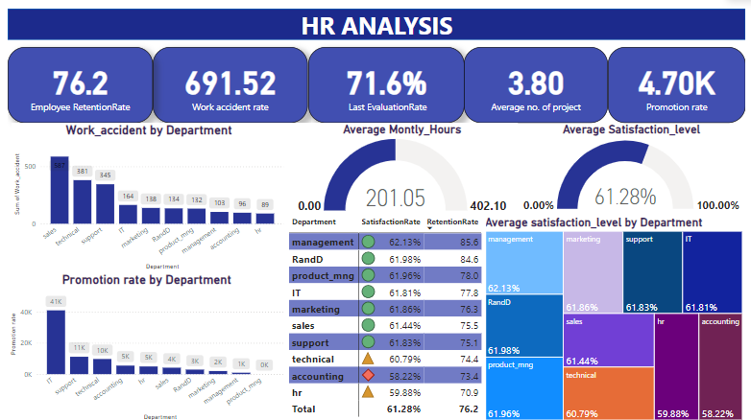

Slide 4
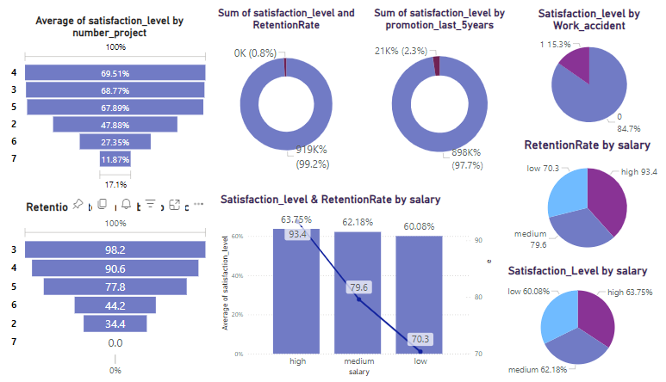

Slide 5
DAX FORMULAS
Promotion rate =
VAR got_promotion=CALCULATE([TotalEmployees],HR_analytics[promotion_last_5years]>0)
RETURN
DIVIDE([Total Employees],got_promotion,0)*100
RetentionRate =
VAR TotalEmployees = COUNTROWS(HR_analytics)
VAR EmployeesWhoLeft = CALCULATE(COUNTROWS(HR_analytics), HR_analytics[left] = 1)
RETURN
DIVIDE(TotalEmployees - EmployeesWhoLeft, TotalEmployees,0) * 100
Work accident rate =
VAR work_accident=CALCULATE([Total Employees],HR_analytics[Work_accident]=1)
RETURN
DIVIDE([Total Employees],work_accident,0)*100
Total Employees = COUNTROWS(HR_analytics)

Slide 6
INSIGHTS
In a company with a total of 15,000 employees, the HR analysis reveals several key insights:
The Management department has the highest satisfaction rate at 62.13%.
The IT department boasts the highest promotion rate among all departments.
The average monthly working hours across the company are 201.05 hours.
The employee retention rate stands at 76.2%, indicating strong employee loyalty.
On average, an employee handles 3 projects, which is linked to higher satisfaction.
The last evaluation rate averages at 71.6%, reflecting overall performance levels.
The work accident rate is 691.52 per 10,000 employees, with the Sales department having the highest accident rate.
The Accounts department reports the lowest satisfaction rate.
Employees handling more than 4 projects tend to experience stress, leading to a decrease in satisfaction, whereas those managing 3 or 4 projects report higher satisfaction.
High salary levels correlate with both high satisfaction and high retention rates.
Higher satisfaction levels are associated with a lower incidence of work accidents.
Employees who received a promotion within the last 5 years show significantly higher satisfaction.
These insights provide a comprehensive overview of employee well-being, satisfaction, and performance across different departments, helping the organization make informed decisions to enhance workplace productivity and employee retention.

Slide 7
SUMMARY
The HR analysis of a company with 15,000 employees reveals that the Management department has the highest satisfaction rate, while the IT department excels in promotions. Employees work an average of 201.05 hours per month, with a retention rate of 76.2%. Handling 3 to 4 projects enhances satisfaction, but more than 4 leads to stress. The Sales department has the highest work accident rate, and the Accounts department faces low satisfaction. Higher salaries and recent promotions correlate with increased satisfaction and retention. To improve satisfaction and retention, it is recommended to:
To enhance employee satisfaction and retention, it is crucial to limit project workloads to a maximum of four, redistributing tasks to prevent burnout.
Improving workplace safety, particularly in the Sales department, through targeted training and revised protocols, will also boost satisfaction.
Focusing on career development by promoting regular advancements, especially in departments with low satisfaction, can be achieved through clear career paths and mentorship programs.
Additionally, aligning compensation with market standards will help retain high-performing employees, while introducing flexible working hours or remote options can improve work-life balance. Finally, conducting regular satisfaction surveys will provide valuable feedback for ongoing improvements.
By implementing these strategies, the company can create a more satisfying and supportive work environment, leading to higher retention rates, increased employee satisfaction, and overall improved organizational performance.

